Slide 1
Health center compliance and health outcomes
HHS Data Science CoLab
Summer 2018
Capstone Presentation
Elizabeth McGill
HRSA/BPHC/ONHS

Slide 2
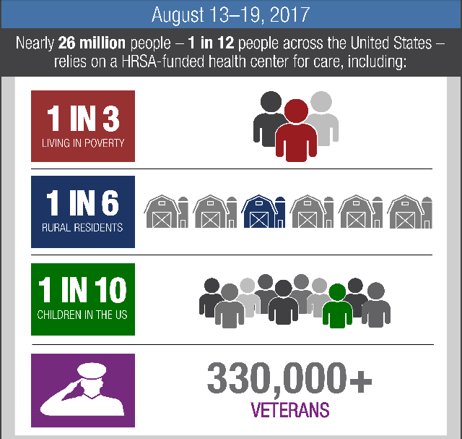
What is the Bureau of Primary Health Care (BPHC)?
BPHC is a grant-making and monitoring agency, founded as a result of the Migrant Health Act of 1962 and the Economic Opportunity Act of 1964, which established funding for the first community-based clinic.
Over 1,400 health center grant recipients operate more than 12,000 community-based clinic sites in every state and territory, giving geographically isolated or economically distressed people access to preventive and primary health care.
Health centers are required to be located in or serve a high-need community and to make their services available to all patients on a sliding scale, based on ability to pay. By law, health centers must be governed by community boards with majority patient representation.

Slide 3
Compliance and Quality
Compliance
Clinical Quality
All grant recipients are required to be in compliance with BPHC’s 18 Program Requirements
Compliance is assessed through onsite reviews and application reviews
When non-compliance is determine, the health center has up to one year to come back into compliance with all Program Requirements
Data source: Progressive Action Condition Compliance Report (1/1/14-12/31/16)
All grant recipients are required to submit the Uniform Data System (UDS) to BPHC annually
UDS provides an annual look-back of both clinical and financial quality measures
12/16 of the clinical measures are linked with CMS eCQMs
Data source: UDS Three-Year Trend Report (1/1/14-12/31/16)

Slide 4
Problem Statement
Routinely compliant health centers achieve higher quality patient outcomes when compared to routinely non-compliant health centers
Compliance is determined by BPHC’s Program Requirements (based on statutory regulation), but helping health centers delivery high-quality health care is ultimately the intent of the program
Bureau-wide impact
Recently created compliance-focused office
Results may impact grant monitoring (60% of BPHC staff)

Slide 5
Drilling down into the data…
Compliance
Clinical Quality
Data Source: Progressive Action Condition Compliance Report
For conditions placed between 1/1/14 and 12/31/16
Variables:
53 possible conditions (areas of non-compliance)
12/53 conditions are related to clinical care
Independent variables
Data source: UDS Three-Year Trend Report
For UDS data related to years: 2014, 2015, & 2016
12/16 of the clinical measures are linked with CMS eCQMs
Will eliminate the diabetes measure
Independent variables
Adjusted Quartile Rankings
Compare health center to health center, controlling for variables

Slide 6
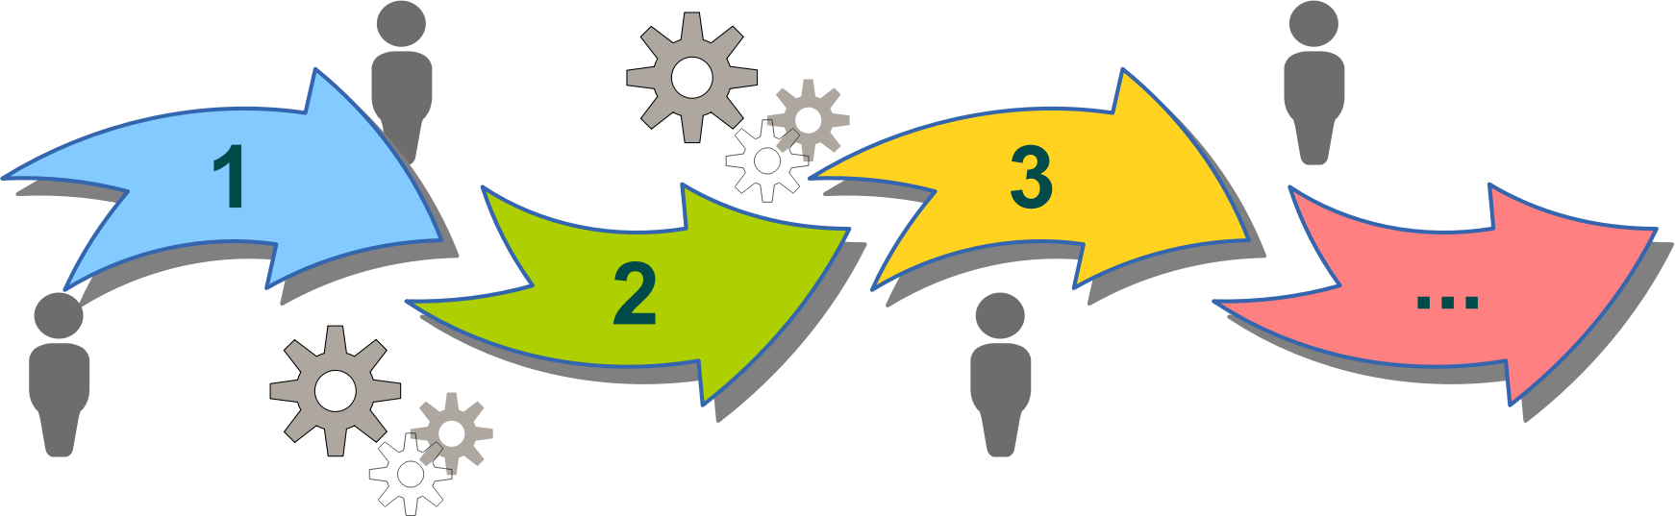
Method
Unsupervised
Both compliance and quality are input variables
Do not know the relationship between compliance and quality
Association
Are compliance and quality related?
Regression statistics
How does compliance account for clinical outcomes?
Independent variables: clinical quality metrics
Dependent variables: number and types of conditions
Challenges:
Controlling for other variables
Coding in R

Slide 7
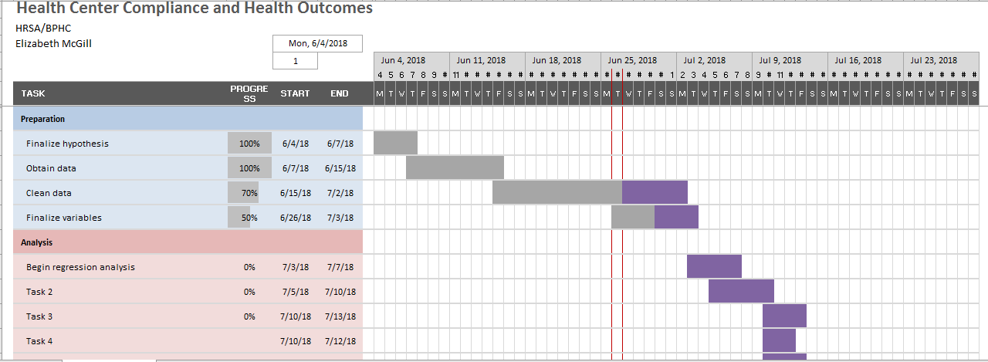
Timeline

